Slide 1






Data Aggregation
How to get data insights?
Databases
Basics
SoftUni Team
Technical Trainers
Software University
http://softuni.bg

Slide 2

Table of Content
Grouping
Aggregate Functions
Having Clause

Slide 3
Questions
sli.do #MYSQL

Slide 4
Grouping
Consolidating data based on criteria

Slide 5
Grouping (1)
Grouping allows taking data into separate groups based on a common property.
Employee | DepartmentName | Salary
Adam
Database Support
5,000
John
Database Support
15,000
Jane
Application Support
10,000
George
Application Support
15,000
Lila
Application Support
5,000
Fred
Software Support
15,000

Slide 6
Grouping (1)
Grouping column
Employee | DepartmentName | Salary
Adam
Database Support
5,000
Can be aggregated
Single row
John
Database Support
15,000
Jane
Application Support
10,000
George
Application Support
15,000
Lila
Application Support
5,000
Fred
Software Support
15,000

Slide 7
Grouping (2)
With GROUP BY you can get each separate group and use an "aggregate" function over it (like Average, Min or Max):
With DISTINCT you will get all unique values:
SELECT e.`department_id`
FROM `employees` AS e
GROUP BY e.`department_id`;
Grouping
Columns
SELECT DISTINCT e.`department_id` FROM `employees` AS e;
Unique Values
Notes:
When we use GROUP BY we can easily achieve distinct values. Grouping leaves only the unique combination of values.
Using the keyword DISTINCT is another way to eliminate the duplicate values. It simplifies the syntax because we don’t have to write down every single column in the GROUP BY part.

Slide 8
Problem: Departments Total Salaries
Use "SoftUni" database to create a query which prints the total sum of salaries for each department.
Order them by DepartmentID (ascending).
Employee | DepartmentID | Salary
Adam | 1 | 5,000
John | 1 | 15,000
Jane | 2 | 10,000
George | 2 | 15,000
Lila | 2 | 5,000
Fred | 3 | 15,000
DepartmentID | TotalSalary
1 | 20,000
2 | 30,000
3 | 15,000
Check your solution here: https://judge.softuni.bg/Contests/Practice/Index/296#18
Notes:
Use grouping to aggregate data. In order to achieve aggregation you need columns that will define the groups. In the case above we will use DepartmentID for aggregation purposes. The column has 3 unique values: “1”, “2” and “3”. Therefore, we will have 3 groups. Moreover, we can sum the salaries of the employees in those departments. If we add the Employee column we will have 6 groups because we have 6 unique combinations of values.

Slide 9
Solution: Departments Total Salaries
After grouping every employee by it's department we can use aggregate function to calculate total amount of money per group.
Grouping Column
New Column Alias
SELECT e.`department_id`,
SUM(e.`salary`) AS 'Total Salary'
FROM `employees` AS e
GROUP BY e.`department_id`
ORDER BY e.`department_id`;
Table Alias
Grouping Columns
Check your solution here: https://judge.softuni.bg/Contests/Practice/Index/296#18
Notes:
SQL provides the functionality by the statement GROUP BY. It is mandatory to have all the columns from the SELECT part in the GROUP BY part. On the other hand, it is possible to have columns in GROUP BY part but not in SELECT part. In this case the groups will be the same as if it was in the SELECT part but the missing columns wouldn’t be visualized.

Slide 10

Aggregate Functions
COUNT, SUM, MAX, MIN, AVG…

Slide 11
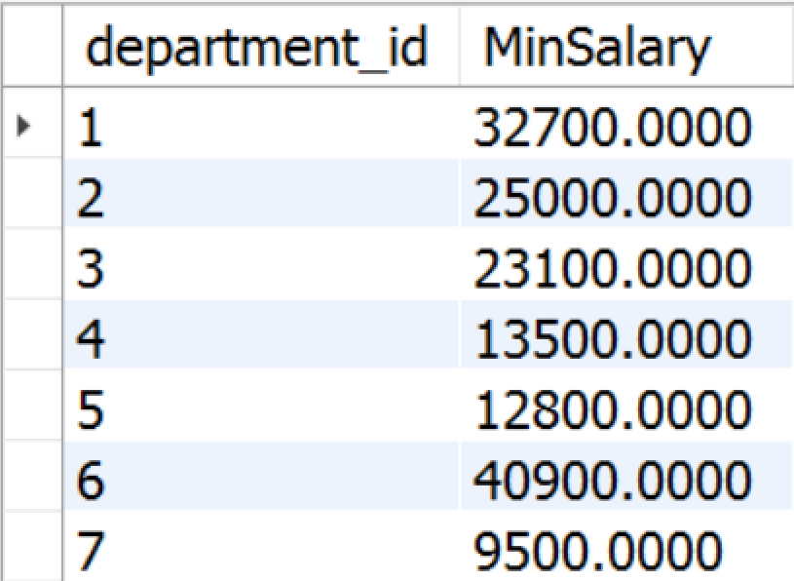
Aggregate Functions
Aggregate functions are used to operate over one or more groups (with some elements in them), performing data analysis on every one.
MIN, MAX, AVG, COUNT etc.
They usually ignore NULL values.
SELECT e.`department_id`,
MIN(e.`salary`) AS 'MinSalary'
FROM `employees` AS e
GROUP BY e.`department_id`;

Slide 12
COUNT
COUNT - counts the values (not nulls) in one or more columns based on grouping criteria.
Employee | DepartmentName | Salary
Adam | Database Support | 5,000
John | Database Support | 15,000
Jane | Application Support | 10,000
George | Application Support | 15,000
Lila | Application Support | 5,000
Fred | Software Support | 15,000
DepartmentName | SalaryCount
Database Support | 2
Application Support | 3
Software Support | 1
Notes:
If any of the values are NULL they are ignored. For example, if one the values is NULL and the other is 5,000 the COUNT will return 1 because it will ignore the NULL value. On the other hand, we can count everything by writing COUNT(*).

Slide 13
COUNT Syntax
Note that we when we use COUNT we will ignore any employee with NULL salary.
Grouping Column
New Column Alias
SELECT e.`department_id`,
COUNT(e.`salary`) AS 'Salary Count'
FROM `employees` AS e
GROUP BY e.`department_id`;
Grouping Columns

Slide 14
SUM
SUM - sums the values in a column.
Employee | DepartmentName | Salary
Adam | Database Support | 5,000
John | Database Support | 15,000
Jane | Application Support | 10,000
George | Application Support | 15,000
Lila | Application Support | 5,000
Fred | Software Support | 15,000
DepartmentName | TotalSalary
Database Support | 20,000
Application Support | 30,000
Software Support | 15,000

Slide 15
SUM Syntax
If any department has no salaries NULL will be displayed.
Grouping Column
New Column Alias
SELECT e.`department_id`, SUM(e.`salary`) AS 'TotalSalary'
FROM `employees` AS e
GROUP BY e.`department_id`;
Table Alias
Grouping Columns

Slide 16
MAX
MAX - takes the maximum value in a column.
Employee | DepartmentName | Salary
Adam | Database Support | 5,000
John | Database Support | 15,000
Jane | Application Support | 10,000
George | Application Support | 15,000
Lila | Application Support | 5,000
Fred | Software Support | 15,000
DepartmentName | MaxSalary
Database Support | 15,000
Application Support | 15,000
Software Support | 15,000
Notes:
NULLs are ignored again.

Slide 17
MAX Syntax
Grouping Column
SELECT e.`department_id`, MAX(e.`salary`) AS 'MaxSalary'
FROM `employees` AS e
GROUP BY e.`department_id`;
New Column Alias
Table Alias
Grouping Columns

Slide 18
MIN
MIN takes the minimum value in a column.
Employee | DepartmentName | Salary
Adam | Database Support | 5,000
John | Database Support | 15,000
Jane | Application Support | 10,000
George | Application Support | 15,000
Lila | Application Support | 5,000
Fred | Software Support | 15,000
DepartmentName | MinSalary
Database Support | 5,000
Application Support | 5,000
Software Support | 15,000

Slide 19
MIN Syntax
Grouping Column
SELECT e.`department_id`, MIN(e.`salary`) AS 'MinSalary'
FROM `employees` AS e
GROUP BY e.`department_id`;
New Column Alias
Table Alias
Grouping Columns

Slide 20
AVG
AVG calculates the average value in a column.
Employee | DepartmentName | Salary
Adam | Database Support | 5,000
John | Database Support | 15,000
Jane | Application Support | 10,000
George | Application Support | 15,000
Lila | Application Support | 5,000
Fred | Software Support | 15,000
DepartmentName | AvgSalary
Database Support | 10,000
Application Support | 10,000
Software Support | 15,000

Slide 21
Demo: AVG Syntax
Grouping Column
New Column Alias
SELECT e.`department_id`,
AVG(e.`salary`) AS 'AvgSalary'
FROM `employees` AS e
GROUP BY e.`department_id`;
Table Alias
Grouping Columns

Slide 22
Having
Using predicates while grouping
Notes:
The HAVING clause is used to filter data based on aggregate values. This means that we cannot use it without grouping before that. Unlike HAVING, the WHERE clause filters rows before the aggregation happens.

Slide 23
Having Clause
The HAVING clause is used to filter data based on aggregate values.
This means that we cannot use it without grouping before that.
Any Aggregate functions (like MIN, MAX, SUM etc.) used both in the "HAVING" clause and in the select statement are executed one time only.
Unlike HAVING, the WHERE clause filters rows before the aggregation happens.

Slide 24
Having Clause: Example
Filter departments which have total salary more or equal 15,000.
Aggregated value
Employee | DepartmentName | Salary
Adam | Database Support | 5,000
John | Database Support | 15,000
Jane | Application Support | 10,000
George | Application Support | 15,000
Lila | Application Support | 5,000
Fred | Software Support | 15,000
TotalSalary
20,000
10,000
15,000
DepartmentName | TotalSalary
Database Support | 20,000
Software Support | 15,000

Slide 25
HAVING Syntax
Grouping Column
Aggregate Function
SELECT e.`department_id`, SUM(e.salary) AS 'TotalSalary'
FROM `employees` AS e
GROUP BY e.`department_id`
HAVING `TotalSalary`< 250000;
New Column Alias
Grouping Columns
Having Predicate

Slide 26


Summary
Grouping
Aggregate Functions
Having
SELECT
SUM(e.`salary) AS 'TotalSalary'
FROM `employees` AS e
GROUP BY e.`department_id`
HAVING SUM(e.`salary`) < 250000;
Databases

Slide 27







Data Aggregation
https://softuni.bg/courses/

Slide 28
License
This course (slides, examples, demos, videos, homework, etc.) is licensed under the "Creative Commons Attribution-NonCommercial-ShareAlike 4.0 International" license
Attribution: this work may contain portions from
"Databases" course by Telerik Academy under CC-BY-NC-SA license

Slide 29




Free Trainings @ Software University
Software University Foundation – softuni.org
Software University – High-Quality Education, Profession and Job for Software Developers
softuni.bg
Software University @ Facebook
facebook.com/SoftwareUniversity
Software University Forums
forum.softuni.bg

